Slide 1
Line Charts and Step Charts

Slide 2
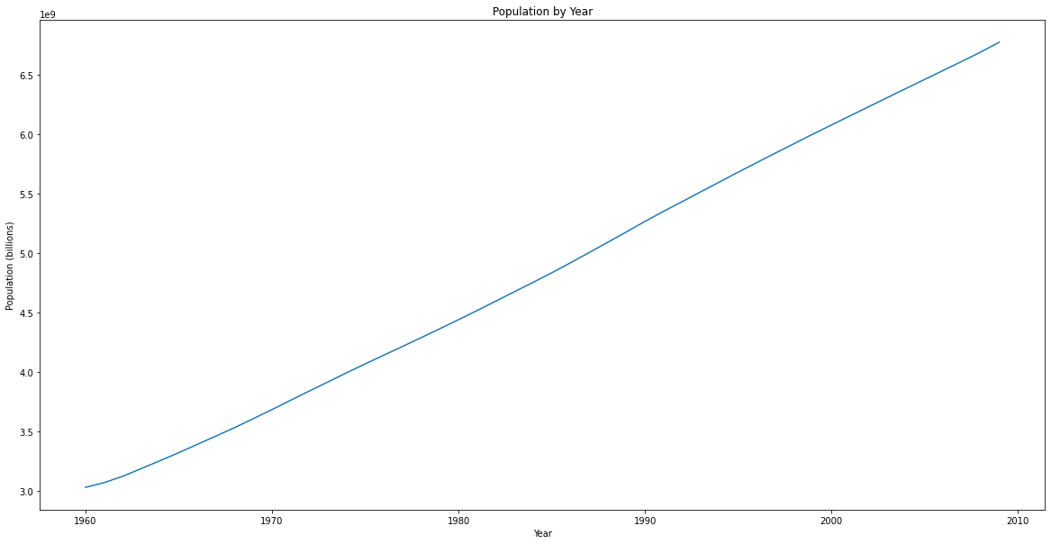

Slide 3
